Slide 1
Explicit Interaction Model towards Text Classification
[ Final Report ]
Cunxiao Du, Zhaozheng Chen, Fuli Feng,
Lei Zhu, Tian Gan, Liqiang NiePiotr
(AAAI ‘19)
Kang Cho
chokang92 @ korea.ac.kr
Data Intelligence Lab, Korea University
2019.12.11

Slide 2
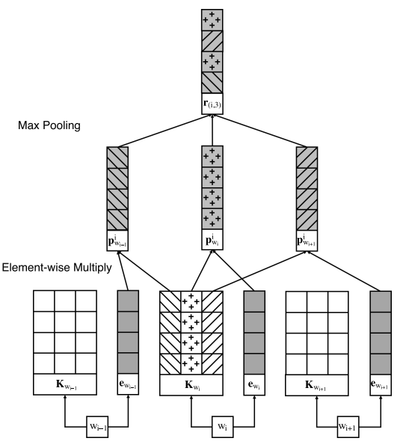



Previous Work
[Region Embedding]
Text-level representation
SUM
〮 〮 〮
$$Word_{1}$$
$$Word_{2}$$
$$Word_{n}$$
[1] Chao Qiao, Bo Huang, Guocheng Niu, Daren Li, Daxiang Dong, Wei He, Dianhai Yu, and Hua Wu, “A New Method of Region Embedding for Text Classification,” in Proceedings of the
International Conference on Learning Represenations, 2018
Notes:
COMMUNICATION / COMMUNICATIVE

Slide 3
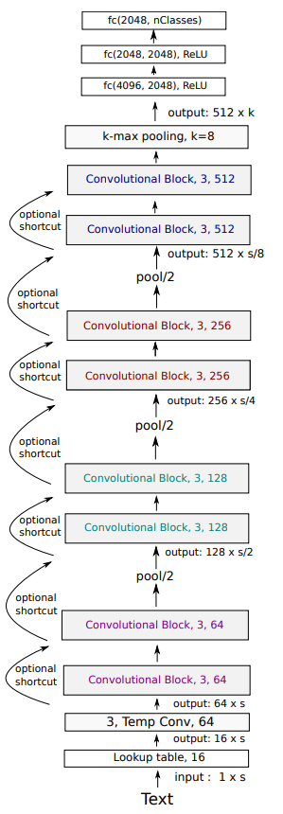
Previous Work
[VDCNN]
Character-level representation
W h a t ㆍㆍㆍ n .
The characters are combined to form N-grams, words, and phrase which are helpful in classification.
[1] Alexis Conneau, Holger Schwenk, and Yann Le Cun, “Very Deep Convolutional Networks for Text Classification,” in Proceedings of the European Chapter of the ACL, p.1107-1116, 2017
Notes:
COMMUNICATION / COMMUNICATIVE

Slide 4



Previous Work
[ Text-level ]
[ Character-level ]
Text-level representation
W h a t ㆍㆍㆍ n .
SUM
It’s difficult to interpret the relationship between words and classes.
〮 〮 〮
$$Word_{1}$$
$$Word_{2}$$
$$Word_{n}$$
Notes:
COMMUNICATION / COMMUNICATIVE

Slide 5
Previous Work
[ Text-level ]
[ Character-level ]
Text-level representation
W h a t ㆍㆍㆍ n .
SUM
It’s difficult to interpret the relationship between words and classes.
〮 〮 〮
Can’t calculate
the relationship score !
$$Word_{1}$$
$$Word_{2}$$
$$Word_{n}$$
Notes:
COMMUNICATION / COMMUNICATIVE

Slide 6
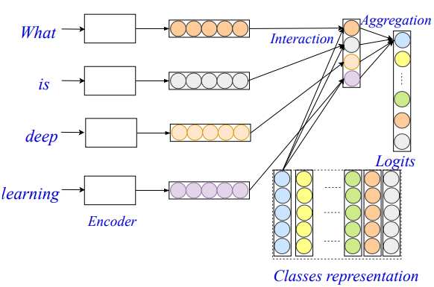
Model
[EXAM model]
Word-level Encoder
First component projects the input text
into a word-level representation.
Interaction Layer
Second component computes the interaction signals between the words and classes.
Aggregation Layer
Third component aggregate the interaction signals for each class and
make the final predictions.
[1,2]
[1] Chao Qiao, Bo Huang, Guocheng Niu, Daren Li, Daxiang Dong, Wei He, Dianhai Yu, and Hua Wu, “A New Method of Region Embedding for Text Classification,” in Proceedings of the
International Conference on Learning Represenations, 2018
[2] Junyoung Chung, Caglar Gulcehre, KyungHyun Cho, and Yoshua Bengio, “Empirical Evaluation of Gated Recurrent Neural Network on Sequence Modeling,” in Computing Research Repository,
abs/1412.3555, 2014

Slide 7
Model
[EXAM model]
Word-level Encoder
First component projects the input text
into a word-level representation.
Interaction Layer
Second component computes the interaction signals between the words and classes.
Aggregation Layer
Third component aggregate the interaction signals for each class and
make the final predictions.
[1,2]
[1] Chao Qiao, Bo Huang, Guocheng Niu, Daren Li, Daxiang Dong, Wei He, Dianhai Yu, and Hua Wu, “A New Method of Region Embedding for Text Classification,” in Proceedings of the
International Conference on Learning Represenations, 2018
[2] Junyoung Chung, Caglar Gulcehre, KyungHyun Cho, and Yoshua Bengio, “Empirical Evaluation of Gated Recurrent Neural Network on Sequence Modeling,” in Computing Research Repository,
abs/1412.3555, 2014

Slide 8
Model
[EXAM model]
Word representation
The
movie
is
funny
.

Slide 9
Model
[EXAM model]
Word representation
The
movie
is
funny
.
Class representation
Class :
#1 #2 #3

Slide 10
Model
[EXAM model]
#1 #2 #3
Word representation
The
The
movie
movie
is
is
funny
funny
.
.
Interaction
Class representation
Class :
#1 #2 #3

Slide 11
Model
[EXAM model]
Relationship between
word “The” and Class “#1”
#1 #2 #3
Word representation
The
The
movie
movie
is
is
funny
funny
.
.
Interaction
Class representation
Class :
#1 #2 #3

Slide 12
Model
[EXAM model]
#1 #2 #3
Word representation
Relationship between
word “movie” and Class “#1”
The
The
movie
movie
is
is
funny
funny
.
.
Interaction
Class representation
Class :
#1 #2 #3

Slide 13
Model
[EXAM model]
#1 #2 #3
The
movie
is
funny
.
Interaction

Slide 14
Model
[EXAM model]
#1 #2 #3
The
movie
is
funny
.
Interaction
Aggregation Weight
Aggregation

Slide 15
Model
[EXAM model]
Relationship between
Sentence “ The movie is funny . “ and Class #1
#1 #2 #3
The
movie
is
funny
.
Interaction
Aggregation Weight
Aggregation

Slide 16
Model
[EXAM model]
Relationship between
Sentence “ The movie is funny . “ and Class #1
#1 #2 #3
The
movie
is
funny
.
Interaction
Aggregation Weight
Aggregation

Slide 17
Model
[EXAM model]
Relationship between
Sentence “ The movie is funny . “ and Class #1
#1 #2 #3
The
movie
is
funny
.
Interaction
Aggregation Weight
Aggregation

Slide 18
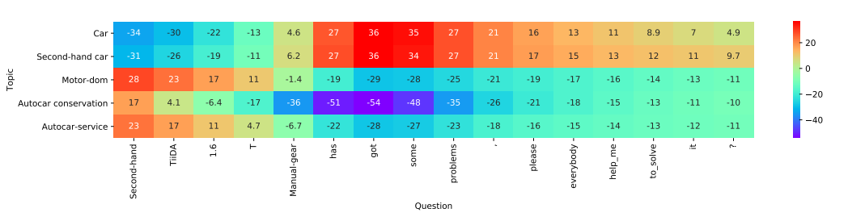
Model
[EXAM model]
#1 #2 #3
The
movie
is
funny
.
Interaction
The interaction mechanism allows you to explicitly interpret
the relationship between words and classes.

Slide 19
Model
[EXAM model]
#1 #2 #3
The
movie
is
funny
.
Interaction
The interaction mechanism allows you to explicitly interpret
the relationship between words and classes.

Slide 20
Experiment
[Data Summary]
Data | Class | Average Lengths | Train Samples | Test Samples | Tasks
Amz. P. | 2 | 91 | 3,600,000 | 400,000 | Sentiment Analysis
Amz. F. | 5 | 93 | 3,000,000 | 650,000 | Sentiment Analysis
AG | 4 | 44 | 120,000 | 7,600 | News Classification
Yah. A. | 10 | 112 | 1,400,000 | 60,000 | Question Answer
DBP | 14 | 55 | 560,000 | 70,000 | Ontology Extraction
Kanshan-Cup Dataset | 1999 | 13 | 3,000,000 | 20,000 | Question Answer
Zhihu Dataset | 1999 | ㆍ | 3,000,000 | 300,000 | Question Answer
Notes:
자세한 Description을 쓸것 / 접근가능한지 아닌지

Slide 21
Experiment
[Hyperparameter Summary]
 | Paper (Open Source) | Basic | Mine
Embedding_size | 128 | 128 | 128
Batch | 16 | 256 | 256
Learning rate | 0.0001 | 0.0001 | 0.0001
Region Size | 7 | 7 | 7
Epoch | 20 | 10 | 10
Word Embedding | - | Random | Uniform(-0.01,0.01)
Class Embedding | - | Random | Uniform(-0.01,0.01)
Aggregation Layer | - | Random | Xavier
Dropout | X (but recommended use) | X | O
L2norm | X (but recommended use) | X | 1e-5, 1e-8
Notes:
자세한 Description을 쓸것 / 접근가능한지 아닌지

Slide 22
Experiment
[Hyperparameter Experiment]
 | Setup | Rate(%) | Accuracy(%)
Basic | - | - | 88.9%
Aggregation | Random->Xavier | +2.1% | 91.0%
Embedding | Random->Uniform | +1.1% | 92.1%
Dropout | X -> O | +0.3% | 92.4%
L2norm | X -> 1e-8 | +0.2% | 92.6%
Notes:
자세한 Description을 쓸것 / 접근가능한지 아닌지

Slide 23
Experiment
[Hyperparameter Experiment]
 | Setup | Rate(%) | Accuracy(%)
Basic | - | - | 88.9%
Aggregation | Random->Xavier | +2.1% | 91.0%
Embedding | Random->Uniform | +1.1% | 92.1%
Dropout | X -> O | +0.3% | 92.4%
L2norm | X -> 1e-8 | +0.2% | 92.6%
Notes:
자세한 Description을 쓸것 / 접근가능한지 아닌지

Slide 24
Experiment
[Hyperparameter Experiment]
 | Setup | Rate(%) | Accuracy(%)
Basic | - | - | 88.9%
Aggregation | Random->Xavier | +2.1% | 91.0%
Embedding | Random->Uniform | +1.1% | 92.1%
Dropout | X -> O | +0.3% | 92.4%
L2norm | X -> 1e-8 | +0.2% | 92.6%
Notes:
자세한 Description을 쓸것 / 접근가능한지 아닌지

Slide 25
Experiment
[Experiment Results in Mulit-Class]
 | Amz. P. | Amz. F. | AG | Yah. A. | DBP
EXAM | 95.5 | 61.9 | 93.0 | 74.8 | 99.0
(Reproduce) | 94.5 | 59.2 | 92.6 | 74.9 | 99.0
EXAM_encoder | 95.1 | 60.9 | 92.8 | 73.1 | 98.9
(Reproduce) | 93.7 | 57.8 | 92.4 | 74.0 | 98.7
Test Set Accuracy [%]
Notes:
자세한 Description을 쓸것 / 접근가능한지 아닌지

Slide 26
Experiment
[Experiment Results in Mulit-Class]
 | Amz. P. | Amz. F. | AG | Yah. A. | DBP
EXAM | 95.5 | 61.9 | 93.0 | 74.8 | 99.0
(Reproduce) | 94.5 | 59.2 | 92.6 | 74.9 | 99.0
EXAM_encoder | 95.1 | 60.9 | 92.8 | 73.1 | 98.9
(Reproduce) | 93.7 | 57.8 | 92.4 | 74.0 | 98.7
Test Set Accuracy [%]
In-prograss
 | Amz. P. | Amz. F. | AG | Yah. A. | DBP
EXAM (Paper) | 95.5 | 61.9 | 93.0 | 74.8 | 99.0
(Reproduce) | 93.8 | 57.8 | 92.6 | 74.9 | 99.0
EXAM_Attention | ㆍ | ㆍ | ㆍ | ㆍ | ㆍ
(Produce) | 93.5 | 57.7 | 92.3 | 74.4 | 99.0
Notes:
자세한 Description을 쓸것 / 접근가능한지 아닌지

Slide 27
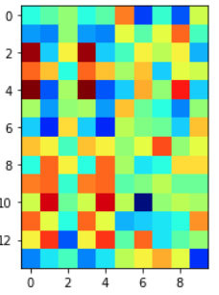
Experiment
[Visualization]
Company
EducationalInstitution
Artist
Althlete
OfficeHolder
MeanOfTransportation
Building
NaturalPlace
Village
Animal
Plant
Album
Film
WrittenWork
Sentence :
Mahru Orostachys ( Mahru Orostachys Indonesian directed tells Review ii
Notes:
자세한 Description을 쓸것 / 접근가능한지 아닌지

Slide 28
Experiment
[Visualization]
Company
EducationalInstitution
Artist
Althlete
OfficeHolder
MeanOfTransportation
Building
NaturalPlace
Village
Animal
Plant
Album
Film
WrittenWork
Sentence :
Mahru Orostachys ( Mahru Orostachys Indonesian directed tells Review ii
Notes:
자세한 Description을 쓸것 / 접근가능한지 아닌지

Slide 29
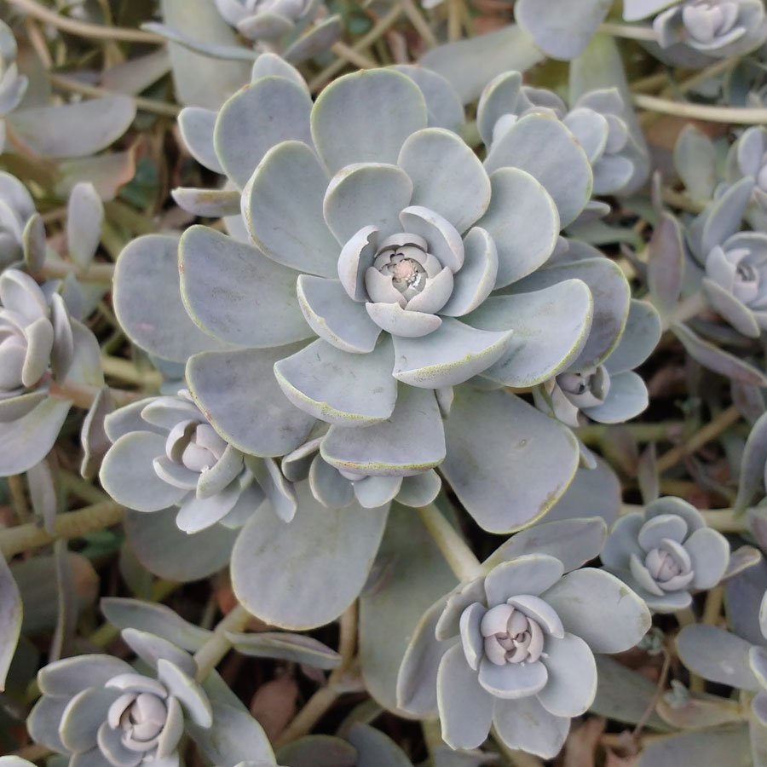
Experiment
[Visualization]
< Orostachys >
Company
EducationalInstitution
Artist
Althlete
OfficeHolder
MeanOfTransportation
Building
NaturalPlace
Village
Animal
Plant
Album
Film
WrittenWork
Sentence :
Mahru Orostachys ( Mahru Orostachys Indonesian directed tells Review ii
Notes:
자세한 Description을 쓸것 / 접근가능한지 아닌지

Slide 30
Experiment
[Visualization]
< Orostachys >
Company
EducationalInstitution
Artist
Althlete
OfficeHolder
MeanOfTransportation
Building
NaturalPlace
Village
Animal
Plant
Album
Film
WrittenWork
We can interpret the relationship
between the two !
Sentence :
Mahru Orostachys ( Mahru Orostachys Indonesian directed tells Review ii
Notes:
자세한 Description을 쓸것 / 접근가능한지 아닌지

Slide 31
Experiment
[Hyperparameter Summary]
 | Paper (Open Source) | Mine
Embedding_size | 256 | 256
Batch | 1000 | 100
Learning rate | 0.001 | 0.001
Epoch | 5 | 5
GRU Cell | 1024 | 1024
Word Embedding | Word2vec | Word2vec
Class Embedding | - | Uniform(-0.01,0.01)
Aggregation Layer | - | Xavier
Dropout | X (but recommended use) | O
L2norm | X (but recommended use) | X
Notes:
자세한 Description을 쓸것 / 접근가능한지 아닌지

Slide 32
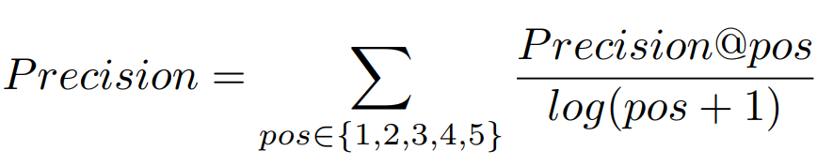
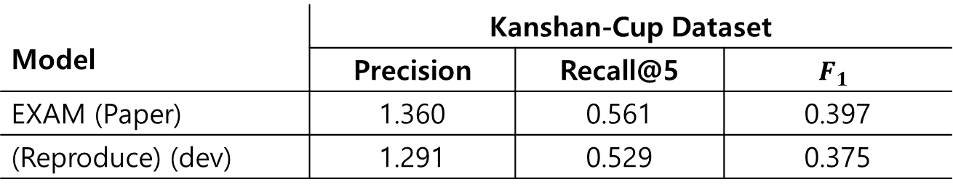
Experiment
[Experiment Results in Mulit-Label]
Model | Kanshan-Cup Dataset
 | Precision | Recall@5 | $$F_{1}$$
EXAM (Paper) | 1.360 | 0.561 | 0.397
(Reproduce) (dev) | 1.291 | 0.529 | 0.375
[1]
[1] Cunxiao Du, Zhaozheng Chen, Fuli Feng, Lei Zhu, Tian Gan, and Liqiang Nie, “Explicit Interaction Model towards Text Classification,” in Proceedings of the Thirty-Third AAAI Conference
on Artificial Intelligence 2019
Notes:
자세한 Description을 쓸것 / 접근가능한지 아닌지

Slide 33
Experiment
[Experiment Results in Mulit-Label]
Model | Kanshan-Cup Dataset
 | Precision | Recall@5 | $$F_{1}$$
EXAM (Paper) | 1.360 | 0.561 | 0.397
(Reproduce) (dev) | 1.291 | 0.529 | 0.375
Dropout : 0.5 – 1.271
Dropout : 0.6 – 1.291
[1]
[1] Cunxiao Du, Zhaozheng Chen, Fuli Feng, Lei Zhu, Tian Gan, and Liqiang Nie, “Explicit Interaction Model towards Text Classification,” in Proceedings of the Thirty-Third AAAI Conference
on Artificial Intelligence 2019
Notes:
자세한 Description을 쓸것 / 접근가능한지 아닌지

Slide 34
Experiment
[Additional Experiment : Running Time]
 | Paper (Open Source) | Basic | Mine
Embedding_size | 128 | 128 | 128
Batch | 16 | 256 | 256
Learning rate | 0.0001 | 0.0001 | 0.0001
Region Size | 7 | 7 | 7
Epoch | 20 | 10 | 10
Word Embedding | - | Random | Uniform(-0.01,0.01)
Class Embedding | - | Random | Uniform(-0.01,0.01)
Aggregation Layer | - | Random | Xavier
Dropout | X (but recommended use) | X | O
L2norm | X (but recommended use) | X | 1e-5, 1e-8
Notes:
자세한 Description을 쓸것 / 접근가능한지 아닌지

Slide 35
Experiment
[Additional Experiment : Running Time]
- Per 1 epoch
 | Paper / batch 16 | Mine / batch 16 | Mine / batch 256
Amz. P. | - | 7h | 39m
Amz. F. | - | 7h | 37m
AG | - | 5m30 | 48s
DBP | - | 1h15 | 7m
Yah. A. | - | 4h06 | 35m
Experiment environment : GPU Tesla K 80 (Google Colab)
Notes:
자세한 Description을 쓸것 / 접근가능한지 아닌지

Slide 36
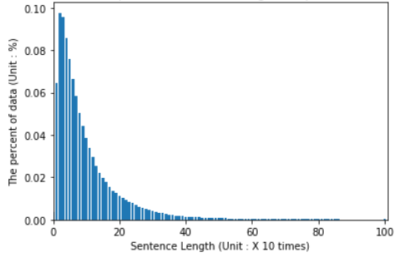
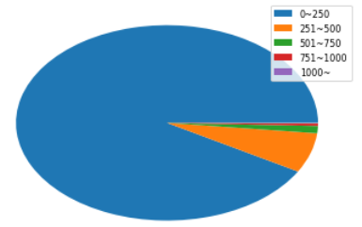
Experiment
[Additional Experiment : Running Time]
- Yahoo! Answers
Distribution of sentence length
Ratio of sentence length
Notes:
자세한 Description을 쓸것 / 접근가능한지 아닌지

Slide 37
Experiment
[Additional Experiment : Running Time]
- Yahoo! Answers
Distribution of sentence length
Ratio of sentence length
1024
The paper uses a maximum sentence length of 1024.
Notes:
자세한 Description을 쓸것 / 접근가능한지 아닌지

Slide 38
Experiment
[Additional Experiment : Running Time]
- Yahoo! Answers
Distribution of sentence length
Ratio of sentence length
512
The paper uses a maximum sentence length of 1024.
However, when the length distribution is referred to,
the data can be analyzed more efficiently.
Notes:
자세한 Description을 쓸것 / 접근가능한지 아닌지

Slide 39
Experiment
[Additional Experiment : Running Time]
- Per 1 epoch
 | Paper / batch 16 | Mine / batch 16 | Mine / batch 256
Amz. P. | - | 7h | 39m
Amz. F. | - | 7h | 37m
AG | - | 5m30 | 48s
DBP | - | 1h15 | 7m
Yah. A. | - | 4h06 | 35m
Experiment environment : GPU Tesla K 80 (Google Colab)
21m
Notes:
성능은 유지하지만 더 1.5배 더 빠르다.

Slide 40
Experiment
[Additional Experiment : EXAM Attention]
 | Amz. P. | Amz. F. | AG | Yah. A. | DBP
EXAM (Paper) | 95.5 | 61.9 | 93.0 | 74.8 | 99.0
(Reproduce) | 94.5 | 59.2 | 92.6 | 74.9 | 99.0
EXAM_Attention | ㆍ | ㆍ | ㆍ | ㆍ | ㆍ
(Produce) | 94.7 | 58.7 | 92.3 | 74.4 | 99.0
[1]
Test Set Accuracy [%]
[1] Dzmitry Bahdanau, KyungHyun Cho, and Yoshua Bengio, “Neural Machine Translation by Jointly Learning to Align and Translate,” in Proceedings of the International Conference on
Learning Represenations, 2018
Notes:
자세한 Description을 쓸것 / 접근가능한지 아닌지

Slide 41
Experiment
[Additional Experiment : EXAM GRU]
Model | AG |  | Yah. A.
 | Accuracy | Time | Accuracy | Time
EXAM (Paper) | 93.0 | ㆍ | 74.8 | ㆍ
(Reproduce) | 92.6 | 48s | 74.9 | 21m
EXAM (GRU) | ㆍ | ㆍ | ㆍ | ㆍ
(Produce) | 91.2 | 26s | 73.6 | 8m 54s
[1]
Test Set Accuracy [%]
[1] Junyoung Chung, Caglar Gulcehre, KyungHyun Cho, and Yoshua Bengio, “Empirical Evaluation of Gated Recurrent Neural Network on Sequence Modeling,” in Computing Research Repository,
abs/1412.3555, 2014
Notes:
자세한 Description을 쓸것 / 접근가능한지 아닌지

Slide 42
Experiment
[Additional Experiment : EXAM GRU]
Model | AG |  | Yah. A.
 | Accuracy | Time | Accuracy | Time
EXAM (Paper) | 93.0 | ㆍ | 74.8 | ㆍ
(Reproduce) | 92.6 | 48s | 74.9 | 21m
EXAM (GRU) | ㆍ | ㆍ | ㆍ | ㆍ
(Produce) | 91.2 | 26s | 73.6 | 8m 54s
[1]
Test Set Accuracy [%]
First,
The region embedding is slower than GRU.
[1] Junyoung Chung, Caglar Gulcehre, KyungHyun Cho, and Yoshua Bengio, “Empirical Evaluation of Gated Recurrent Neural Network on Sequence Modeling,” in Computing Research Repository,
abs/1412.3555, 2014
Notes:
자세한 Description을 쓸것 / 접근가능한지 아닌지

Slide 43
Experiment
[Additional Experiment : EXAM GRU]
Model | AG |  | Yah. A.
 | Accuracy | Time | Accuracy | Time
EXAM (Paper) | 93.0 | ㆍ | 74.8 | ㆍ
(Reproduce) | 92.6 | 48s | 74.9 | 21m
EXAM (GRU) | ㆍ | ㆍ | ㆍ | ㆍ
(Produce) | 91.2 | 26s | 73.6 | 8m 54s
[1]
Test Set Accuracy [%]
First,
The region embedding is slower than GRU.
Second,
The region embedding performs better than GRU.
[1] Junyoung Chung, Caglar Gulcehre, KyungHyun Cho, and Yoshua Bengio, “Empirical Evaluation of Gated Recurrent Neural Network on Sequence Modeling,” in Computing Research Repository,
abs/1412.3555, 2014
Notes:
자세한 Description을 쓸것 / 접근가능한지 아닌지

Slide 44
Experiment
[Additional Experiment : EXAM GRU]
Model | AG |  | Yah. A.
 | Accuracy | Time | Accuracy | Time
EXAM (Paper) | 93.0 | ㆍ | 74.8 | ㆍ
(Reproduce) | 92.6 | 48s | 74.9 | 21m
EXAM (GRU) | ㆍ | ㆍ | ㆍ | ㆍ
(Produce) | 91.2 | 26s | 73.6 | 8m 54s
[1]
Test Set Accuracy [%]
First,
The region embedding is slower than GRU.
Second,
The region embedding performs better than GRU.
The GRU uses contextual information for the entire sentence, but it is difficult to maintain long-term dependencies in long sentences.
[1] Junyoung Chung, Caglar Gulcehre, KyungHyun Cho, and Yoshua Bengio, “Empirical Evaluation of Gated Recurrent Neural Network on Sequence Modeling,” in Computing Research Repository,
abs/1412.3555, 2014
Notes:
자세한 Description을 쓸것 / 접근가능한지 아닌지

Slide 45
Conclusion
This model performs better than encoder-based model by reflecting the relationship between words and classes.
This model can be explicitly interpreted by computing each words and classes in a sentence.
They analyzed the performance effectively by using a word-level encoder suitable for the data distribution.
Notes:
자세한 Description을 쓸것 / 접근가능한지 아닌지

Slide 46
Q&A
Q & A
Notes:
FastText 수정사항 embedding
논문두개합치기
해싱 어떻게든
실험은 분리, / 정확한설명덧붙어ㅕ서
Task 각각에 대해 간단하게

Slide 47
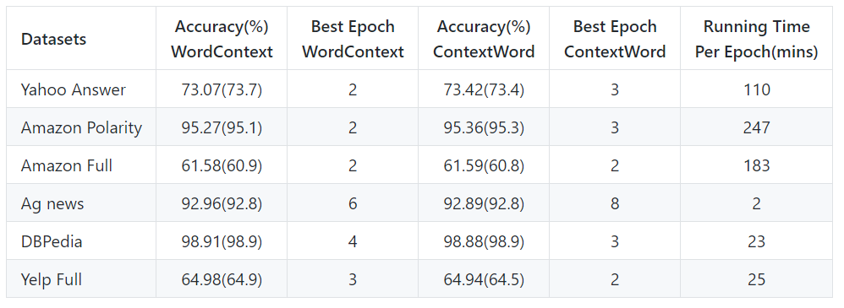
Appendix
Experiment environment : Titan Xp GPU
[1] Chao Qiao, Bo Huang, Guocheng Niu, Daren Li, Daxiang Dong, Wei He, Dianhai Yu, and Hua Wu, “A New Method of Region Embedding for Text Classification”, in Proceedings of the
International Conference on Learning Represenations, 2018
Notes:
FastText 수정사항 embedding
논문두개합치기
해싱 어떻게든
실험은 분리, / 정확한설명덧붙어ㅕ서
Task 각각에 대해 간단하게

Slide 48
Appendix
[Compared model]
Word representation
The
SUM
movie
Text representation
is
The movie is funny .
funny
Express textual content
simply by summing words.
.
Classified but difficult to interpret
relationship with class.

Slide 49
Appendix
[EXAM model]
The movie is funny .
Compress information into one representation
Keep each information
#1 #2 #3
The
movie
is
funny
.
Interaction

Slide 50
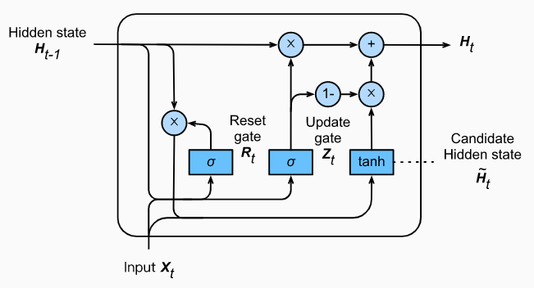



Appendix
[Word-level Encoder]
Gated Recurrent Units
Reset Gate $R_{t} : σ(W_{xr}X_{t}+W_{hr}H_{t−1})$
$$\hat{H_{t}}=tanh⁡({W_{xh}X}_{t}+W_{hh}\left(R_{t}{ㆍH}_{t−1}\right))$$
The Gate controls the use
of previous information.
Update Gate $Z_{t}: σ\left(X_{t}W_{xz}+H_{t−1}W_{hz}\right)$
$$H_{t}=Z_{t}{ㆍH}_{t−1}+\left(1−Z_{t}\right)ㆍ \hat{H_{t}}$$
The Gate determines the weight
ratio of previous information.
GRU has the ability of capturing sequential dependency.

Slide 51
Appendix
[Word-level Encoder]
2. Region Embedding
The food is not very good in this hotel.
Region size : window size ⅹ 2 + 1
$Position_{i−2}$ $Position_{i−1}$ $Position_{i}$ $Position_{i+1}$ $Position_{i+2}$
Meaning
Embedding about meaning
$Position_{i−2}$ $Position_{i−1}$ $Position_{i}$ $Position_{i+1}$ $Position_{i+2}$
Embedding about position

Slide 52





Appendix
[Word-level Encoder]
2. Region Embedding
The food is not very good in this hotel.
$Position_{i−2}$ $Position_{i−1}$ $Position_{i}$ $Position_{i+1}$ $Position_{i+2}$
Embedding weight about meaning
Lookup
food
$${e_{not}}_{i−2}$$
Concate
is
${e_{not}}_{i−1}$
not
$${e_{not}}_{i}$$
very
$${e_{not}}_{i+1}$$
good
$${e_{not}}_{i+2}$$

Slide 53
Appendix
[Word-level Encoder]
2. Region Embedding
The food is not very good in this hotel.
$Position_{i−2}$ $Position_{i−1}$ $Position_{i}$ $Position_{i+1}$ $Position_{i+2}$
Embedding weight about position
$Position_{i−2}$ $Position_{i−1}$ $Position_{i}$ $Position_{i+1}$ $Position_{i+2}$
not
Concate

Slide 54





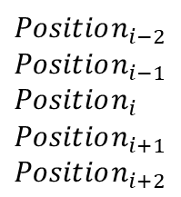
Appendix
[Word-level Encoder]
2. Region Embedding
The food is not very good in this hotel.
$Position_{i−2}$ $Position_{i−1}$ $Position_{i}$ $Position_{i+1}$ $Position_{i+2}$
$Position_{i−2}$
$Position_{i−1}$
$Position_{i}$
$Position_{i+1}$
$Position_{i+2}$
$${e_{not}}_{i−2}$$
$${e_{not}}_{i−1}$$
$${e_{not}}_{i}$$
$${e_{not}}_{i+1}$$
$${e_{not}}_{i+2}$$

Slide 55
Appendix
[Word-level Encoder]
2. Region Embedding
The food is not very good in this hotel.
$Position_{i−2}$ $Position_{i−1}$ $Position_{i}$ $Position_{i+1}$ $Position_{i+2}$
Element-wise
multiplication
$Position_{i−2}$
$Position_{i−1}$
$Position_{i}$
$Position_{i+1}$
$Position_{i+2}$
$${e_{not}}_{i−2}$$
$${e_{not}}_{i−1}$$
$${e_{not}}_{i}$$
$${e_{not}}_{i+1}$$
$${e_{not}}_{i+2}$$

Slide 56
Appendix
[Word-level Encoder]
2. Region Embedding
The food is not very good in this hotel.
$Position_{i−2}$ $Position_{i−1}$ $Position_{i}$ $Position_{i+1}$ $Position_{i+2}$
Element-wise
multiplication
$Position_{i−2}$
$Position_{i−1}$
$Position_{i}$
$Position_{i+1}$
$Position_{i+2}$
$${e_{not}}_{i−2}$$
$${e_{not}}_{i−1}$$
$${e_{not}}_{i}$$
$${e_{not}}_{i+1}$$
Max-pooling
$${e_{not}}_{i+2}$$

Slide 57
Appendix
[Word-level Encoder]
To utilizing task-specific
distributed representation.
2. Region Embedding
The food is not very good in this hotel.
$Position_{i−2}$ $Position_{i−1}$ $Position_{i}$ $Position_{i+1}$ $Position_{i+2}$
Element-wise
multiplication
$Position_{i−2}$
$Position_{i−1}$
$Position_{i}$
$Position_{i+1}$
$Position_{i+2}$
$${e_{not}}_{i−2}$$
$${e_{not}}_{i−1}$$
$${e_{not}}_{i}$$
$${e_{not}}_{i+1}$$
Max-pooling
$${e_{not}}_{i+2}$$
: Embedding on
the word ‘not’

Slide 58
Appendix
[Additional Experiment : EXAM Attention]
The
movie
is
funny
.
#1 #2 #3
0.1
0.0
0.3
The
movie
0.2
0.5
0.6
is
softmax
0.0
0.1
0.1
funny
.
0.7
0.2
0.0
#1 #2 #3
0.0
0.2
0.0

Slide 59
Appendix
[Additional Experiment : EXAM Attention]
Attention about #1
Attention about #2
Attention about #3
The
movie
X 0.1
X 0.0
X 0.3
+
+
+
is
X 0.2
X 0.5
X 0.6
funny
+
+
+
X 0.0
X 0.1
X 0.1
.
+
+
+
X 0.7
X 0.2
X 0.0
0.3
+
+
+
0.1
0.0
X 0.0
X 0.2
X 0.0
0.2
0.5
0.6
0.0
0.1
0.1
< #1 > text representation
0.7
0.2
0.0
< #2 > text representation
0.0
0.2
0.0
< #3 > text representation

Slide 60
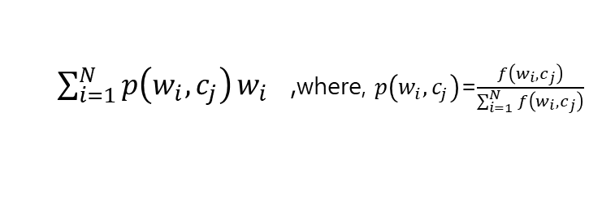
Appendix
[Additional Experiment : EXAM Attention]
$$w_{i} :word representation, c_{j} :class representation,$$
$$i :length of sentence , j :the number of classes$$
#1 #2 #3
Attention about #1
Attention about #2
Attention about #3
The
X 0.1
X 0.0
X 0.3
+
+
+
movie
X 0.2
X 0.5
X 0.6
+
+
+
is
X 0.0
X 0.1
X 0.1
+
+
+
funny
X 0.7
X 0.2
X 0.0
+
+
+
.
X 0.0
X 0.2
X 0.0
Interaction
[$f\left(w_{1}, c_{j}\right)$; $f\left(w_{2}, c_{j}\right);〮〮〮 ;f\left(w_{N}, c_{j}\right)$] ,where $f\left(w_{i}, c_{j}\right)$=$w_{i}ㆍc_{j}$
$\sum_{i=1}^{N}{p\left(w_{i}, c_{j}\right)}w_{i}$ ,where, $p\left(w_{i}, c_{j}\right)$=$\frac{f\left(w_{i}, c_{j}\right)}{\sum_{i=1}^{N}{f\left(w_{i}, c_{j}\right)}}$

Slide 61

Appendix
[Additional Experiment : EXAM Attention]
EXAM : [$f\left(w_{N}, c_{j}\right)$; $f\left(w_{N}, c_{j}\right);〮〮〮 ;f\left(w_{N}, c_{j}\right)$]
Each has a unique value between the class and the word.

Slide 62
Appendix
[Additional Experiment : EXAM Attention]
EXAM : [$f\left(w_{N}, c_{j}\right)$; $f\left(w_{N}, c_{j}\right);〮〮〮 ;f\left(w_{N}, c_{j}\right)$]
Each has a unique value between the class and the word.
#1 #2 #3
Class :
#1 #2 #3
The
movie
Sentence :
The movie is funny .
is
funny
.
Interaction

Slide 63
Appendix
[Additional Experiment : EXAM Attention]
EXAM : [$f\left(w_{N}, c_{j}\right)$; $f\left(w_{N}, c_{j}\right);〮〮〮 ;f\left(w_{N}, c_{j}\right)$]
Each has a unique value between the class and the word.
#1 #2 #3
Class :
#1 #2 #3
The
movie
Sentence :
The movie is funny .
is
funny
.
Interaction

Slide 64
Appendix
[Additional Experiment : EXAM Attention]
EXAM : [$f\left(w_{N}, c_{j}\right)$; $f\left(w_{N}, c_{j}\right);〮〮〮 ;f\left(w_{N}, c_{j}\right)$]
Each has a unique value between the class and the word.
#1 #2 #3
Class :
#1 #2 #3
The
movie
Sentence :
The movie is funny .
is
funny
.
Interaction

Slide 65
Appendix
[Additional Experiment : EXAM Attention]
EXAM : [$f\left(w_{N}, c_{j}\right)$; $f\left(w_{N}, c_{j}\right);〮〮〮 ;f\left(w_{N}, c_{j}\right)$]
Each has a unique value between the class and the word.
#1 #2 #3
Class :
#1 #2 #3
The
movie
Sentence :
The movie is funny .
is
funny
.
Interaction

Slide 66
Appendix
[Additional Experiment : EXAM Attention]
EXAM : [$f\left(w_{N}, c_{j}\right)$; $f\left(w_{N}, c_{j}\right);〮〮〮 ;f\left(w_{N}, c_{j}\right)$]
Each has a unique value between the class and the word.
#1 #2 #3
Class :
#1 #2 #3
The
movie
Sentence :
The movie is funny .
is
funny
.
Interaction

Slide 67
Appendix
[Additional Experiment : EXAM Attention]
EXAM : [$f\left(w_{N}, c_{j}\right)$; $f\left(w_{N}, c_{j}\right);〮〮〮 ;f\left(w_{N}, c_{j}\right)$]
Each has a unique value between the class and the word.
#1 #2 #3
Class :
#1 #2 #3
The
movie
Sentence :
The movie is funny .
is
funny
.
Interaction

Slide 68
Appendix
[Additional Experiment : EXAM Attention]
EXAM : [$f\left(w_{N}, c_{j}\right)$; $f\left(w_{N}, c_{j}\right);〮〮〮 ;f\left(w_{N}, c_{j}\right)$]
Each has a unique value between the class and the word
#1 #2 #3
Class :
#1 #2 #3
The
movie
Sentence :
The movie is funny .
is
funny
.
Interaction

Slide 69
Appendix
[Additional Experiment : EXAM Attention]
EXAM : [$f\left(w_{N}, c_{j}\right)$; $f\left(w_{N}, c_{j}\right);〮〮〮 ;f\left(w_{N}, c_{j}\right)$]
Each has a unique value between the class and the word.

Slide 70
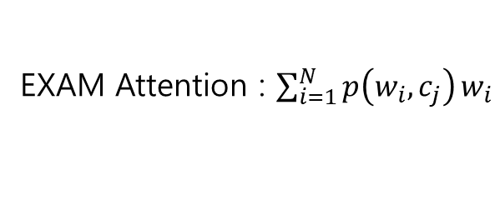
Appendix
[Additional Experiment : EXAM Attention]
EXAM : [$f\left(w_{N}, c_{j}\right)$; $f\left(w_{N}, c_{j}\right);〮〮〮 ;f\left(w_{N}, c_{j}\right)$]
Each has a unique value between the class and the word.
EXAM Attention : $\sum_{i=1}^{N}{p\left(w_{i}, c_{j}\right)}w_{i}$
Attention reflects the importance of each word in a sentence.

Slide 71
Appendix
[Additional Experiment : EXAM Attention]
EXAM : [$f\left(w_{N}, c_{j}\right)$; $f\left(w_{N}, c_{j}\right);〮〮〮 ;f\left(w_{N}, c_{j}\right)$]
Each has a unique value between the class and the word.
EXAM Attention : $\sum_{i=1}^{N}{p\left(w_{i}, c_{j}\right)}w_{i}$
Attention reflects the importance of each word in a sentence.
Class :
#1 #2 #3
Attention about #1
Attention about #2
Attention about #3
X 0.1
+
X 0.0
+
X 0.3
+
X 0.2
X 0.5
X 0.6
+
X 0.0
+
X 0.1
+
X 0.1
Sentence :
+
+
X 0.2
+
X 0.0
The movie is funny .
+
X 0.7
+
+
X 0.0
X 0.2
X 0.0

Slide 72
Appendix
[Additional Experiment : EXAM Attention]
EXAM : [$f\left(w_{N}, c_{j}\right)$; $f\left(w_{N}, c_{j}\right);〮〮〮 ;f\left(w_{N}, c_{j}\right)$]
Each has a unique value between the class and the word.
EXAM Attention : $\sum_{i=1}^{N}{p\left(w_{i}, c_{j}\right)}w_{i}$
Attention reflects the importance of each word in a sentence.
Class :
#1 #2 #3
Attention about #1
Attention about #2
Attention about #3
X 0.1
+
X 0.0
+
X 0.3
+
X 0.2
X 0.5
X 0.6
+
X 0.0
+
X 0.1
+
X 0.1
Sentence :
+
+
X 0.2
+
X 0.0
The movie is funny .
+
X 0.7
+
+
X 0.0
X 0.2
X 0.0

Slide 73
Appendix
[Additional Experiment : EXAM Attention]
EXAM : [$f\left(w_{N}, c_{j}\right)$; $f\left(w_{N}, c_{j}\right);〮〮〮 ;f\left(w_{N}, c_{j}\right)$]
Each has a unique value between the class and the word.
EXAM Attention : $\sum_{i=1}^{N}{p\left(w_{i}, c_{j}\right)}w_{i}$
Attention reflects the importance of each word in a sentence.
Class :
#1 #2 #3
Attention about #1
Attention about #2
Attention about #3
X 0.1
+
X 0.0
+
X 0.3
+
X 0.2
X 0.5
X 0.6
+
X 0.0
+
X 0.1
+
X 0.1
Sentence :
+
+
X 0.2
+
X 0.0
The movie is funny .
+
X 0.7
+
+
X 0.0
X 0.2
X 0.0

Slide 74
Appendix
[Additional Experiment : EXAM Attention]
EXAM : [$f\left(w_{N}, c_{j}\right)$; $f\left(w_{N}, c_{j}\right);〮〮〮 ;f\left(w_{N}, c_{j}\right)$]
Each has a unique value between the class and the word.
EXAM Attention : $\sum_{i=1}^{N}{p\left(w_{i}, c_{j}\right)}w_{i}$
Attention reflects the importance of each word in a sentence.
Class :
#1 #2 #3
Can’t evaluate which one is better,
Sentence :
The movie is funny .
Notes:
어떤 것이 더 좋을지는 평가할 수 없지만 단어 자체에 집중하고싶다면 전자를 문장 전체에서의 단어의 역할에 집중하고싶다면 후자를 선택하는 것이 옳을 것이다
You can't evaluate which one is better, but if you want to focus on the word itself, you can choose the latter if you want to focus on the role of the word in the whole sentence.

